Slide 1
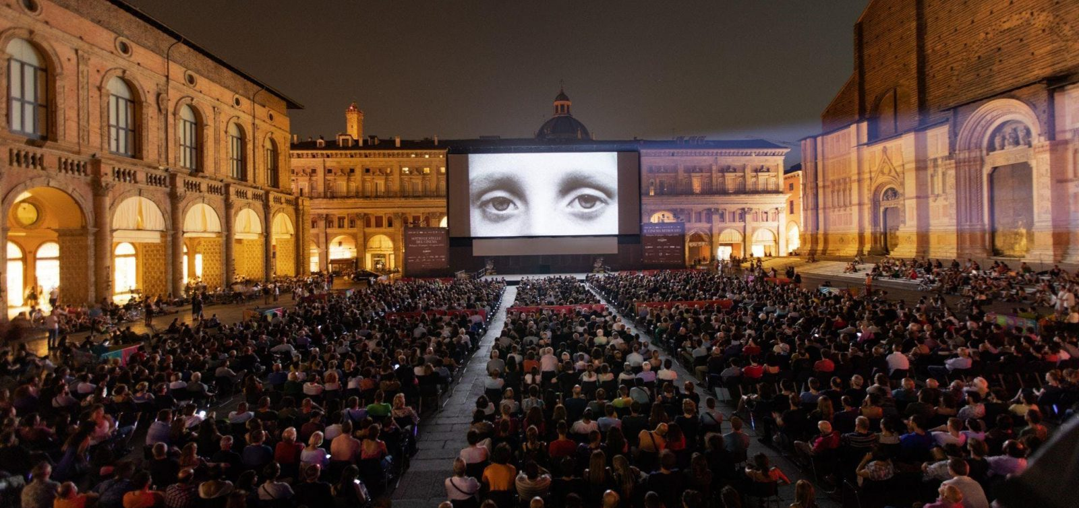
Cineteca di Bologna
Final Design Highlights
Francesca Mangialardo 0000904129
Carlo Teo Pedretti 0000903167
Mattia Spadoni 0000906249

Slide 2
Cinema Lumière subsite
Here we propose a subsite of the Cineteca main website which is fully dedicated to the cinema environment, leaving untouched the archival, library and education sections.
Contents: any information related to cinema showing activities (movie schedule, events, tariffs…)
Services: online ticket purchase
Our website is addressed to a specific population segment that is unresponsive because they prefer to carry out the ticket purchase in real life without the use of a digital tool.
Notes:
matti
Contenuti+Servizi, trovare la quadra, subsito+target users

Slide 3
Users goals and needs
Our users are young people between 14 and 24 years old that are fairly organized and curiously looking for external stimuli. They easily get distracted and bored and they use devices and online services only for specific activities.
Cinema is perceived as a moment of relax and escape from everyday life
Going to cinema is an highly social activity
They want to find information quickly
They want to use their smartphone without having to download an app
They enjoy simple and essential websites
Notes:
teo
SEGMENTATION / USER RESEARCH / CONTEXTUAL INQUIRY

Slide 4
How can we motivate users?
Anticipate their goals
consult the schedule (two main paths were identified movie first, date first)
find information about costs and promotions
purchase tickets online
Guide them step by step in the most relevant tasks
Promote only engaging and useful interactions that give a sense of control and completion and maintain interest
Reduce cognitive load exploiting simplicity and consistency
Present only pertinent and necessary information
Notes:
fra SCAFFOLDING

Slide 5
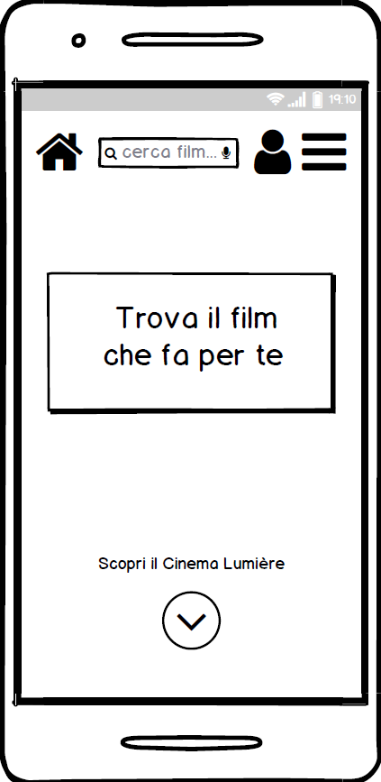
Homepage
Few components
Call to action brings to the schedule
Name of the cinema clearly identified
Utility navigation tools speed expert users
Notes:
fra

Slide 6
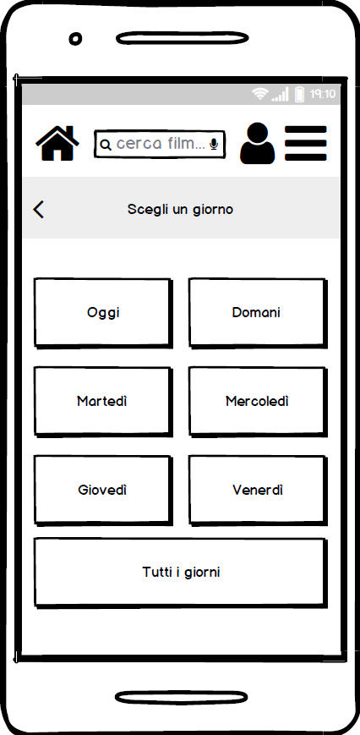
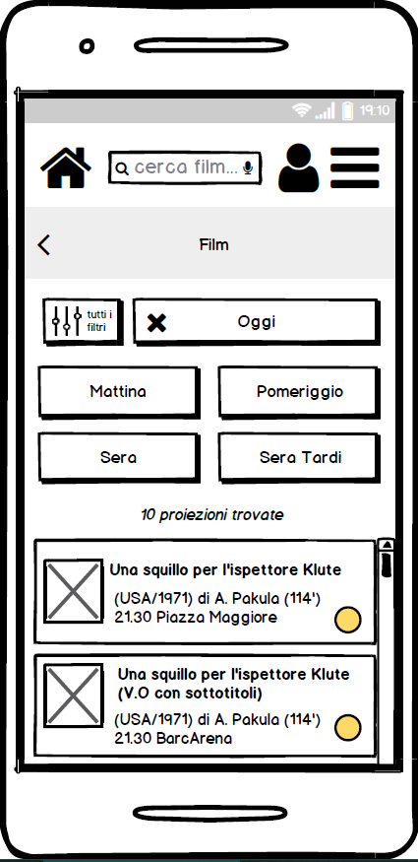
Schedule
1.
2.
Step by step procedure guarantees concentration
Progressive top-down filtering stimulates the future approach
Active filters remain visible to help short term memory load
Movies list is automatically updated
Notes:
matti Sistema di filtri

Slide 7
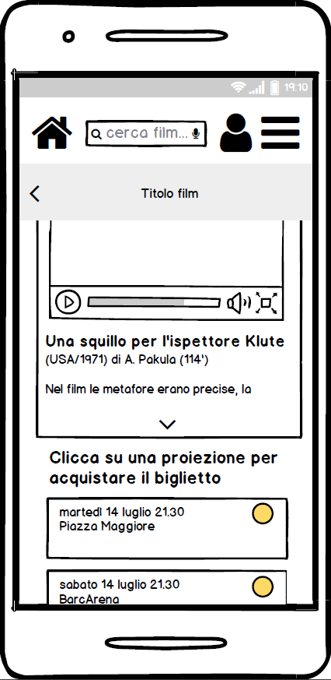
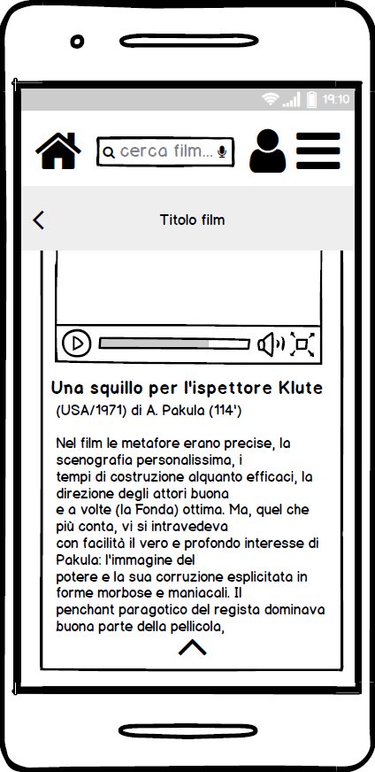
Movie page
Only the most relevant information are immediately shown (with trailer)
More details can be found expanding the container
Below the movie content container is the movie showings list (ordered for day and time)
Visual division between exclusive information content and call to action to proceed with the purchase
Notes:
teo

Slide 8
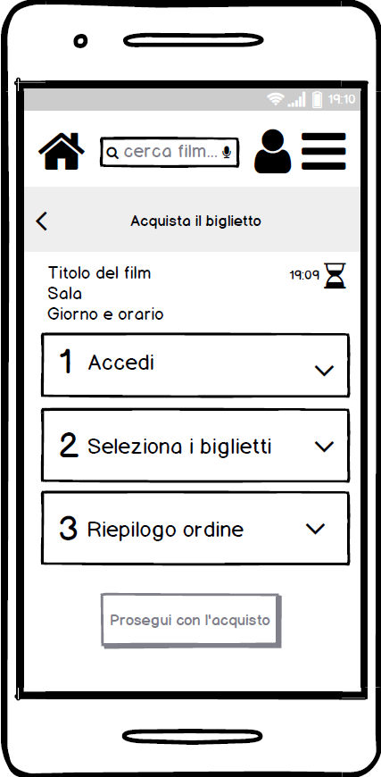
Ticket purchase
Ordered three-steps procedure gives feeling of control on the process
Order summary is displayed on the screen as a reminder
Countdown is discrete and does not generate anxiety
Impossible to proceed unless all steps are validated
Notes:
fra

Slide 9
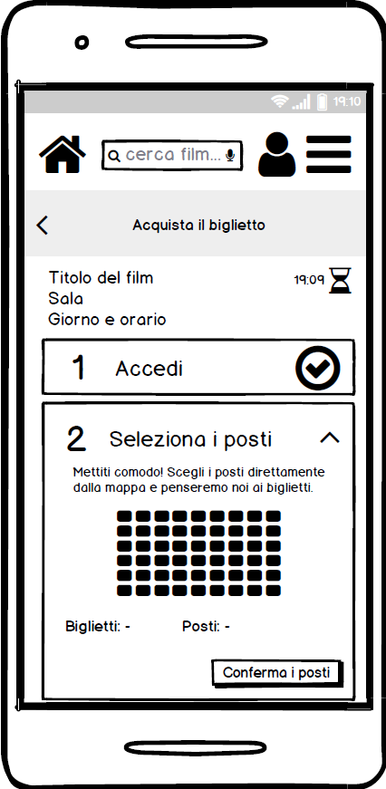
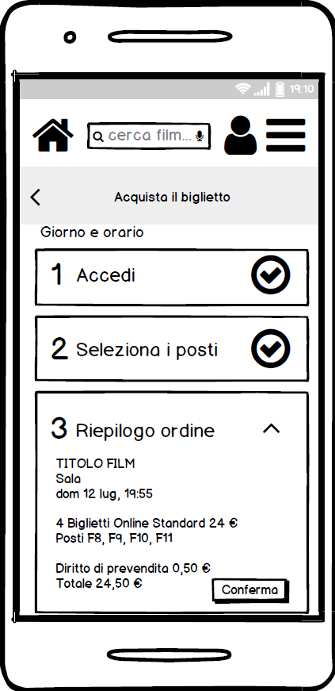
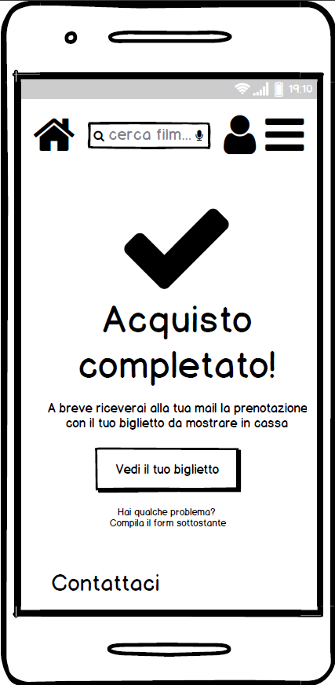
Tickets purchase - 2
1.
2.
Selection of seats number and area in the same step
An automatic counter gives feedback of the selection
Ticket confirmation via completed purchase message
3.
Notes:
teo

Slide 10
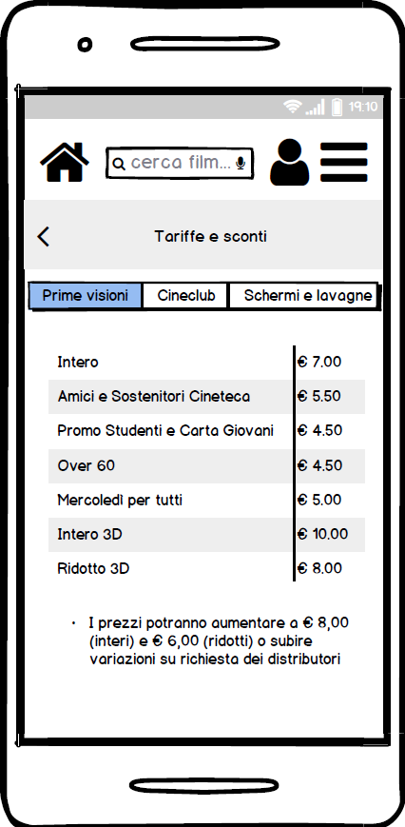
Costs
Table structure
Clear costs organization based on promotions
Button selection for various initiatives
Notes:
matti

Slide 11
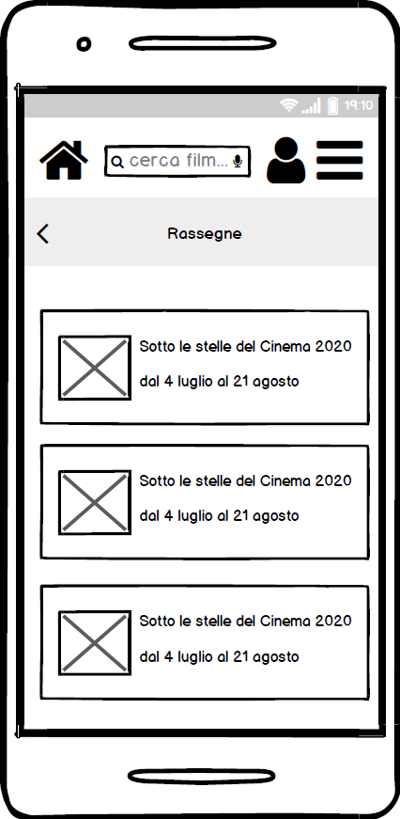
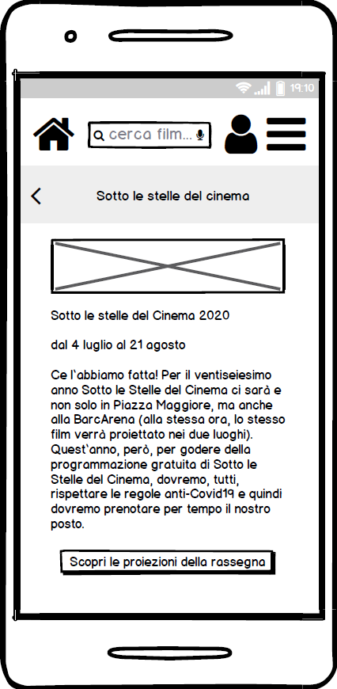
Events
1.
2.
List of cinema events promoted by the institution
Events pages with full information
Call to action to an already filtered events schedule
Notes:
matti

Slide 12
Users feedback
100%
of the tested users were able to carry out relevant tasks. This result is impressive when compared to the metrics collected for our competitor analysis, that only reached 44%.
The website was evaluated through a system usability scale questionnaire and scored 96%.
Notes:
teo

Slide 13
Further developments
Desktop website UX design
Complete Cineteca website redesign
Deeper research on the younger user segment to understand why they are less performing in the tasks, since we saw in the tests a correlation between age and performance
Notes:
teo

Slide 14
Thank you!
Notes:
teo

